Slide 1
WORKPLACE ETIQUETTE
2024

Slide 2

What is Workplace Etiquette?
Workplace etiquette is the set of norms and standards that govern professional behavior in a workplace.
It is essential for creating a positive and productive work environment.
Good workplace etiquette establishes respect, fosters collaboration, and improves productivity.
Office etiquette is crucial for maintaining a professional demeanor and upholding the reputation of the organization.
Professional behavior and ethics establish trust and build strong relationships between colleagues and superiors.

Slide 3
PRINCIPLES OF WORKPLACE ETIQUETTE:
RESPECT FOR PERSONAL SPACE
COMMUNICATION
DRESS CODE
TIME MANAGEMENT
TEAMWORK

Slide 4

COMMUNICATION:
Effective communication is essential for maintaining workplace etiquette.
Active listening is a critical aspect of effective communication as it enables one to understand others’ perspectives and respond appropriately.
DRESS CODE:
Dressing appropriately and maintaining personal hygiene is crucial for creating a professional work environment.
RESPECT FOR PERSONAL SPACE:
Respecting personal space and privacy involves recognizing and taking into account the boundaries of colleagues and ensuring that their space and privacy are not intruded upon.

Slide 5
TIME MANAGEMENT:
Being on time is a fundamental aspect of workplace etiquette
To manage your time effectively, prioritize your tasks and communicate with your colleagues to ensure everyone is on the same page.
Set realistic goals and establish a routine that allows you to complete your work efficiently without sacrificing quality.
TEAMWORK:
Teamwork is essential aspect of workplace etiquette that contribute to a positive work culture
Working with others toward a common goal requires mutual respect, effective communication, and cooperation.

Slide 6
Communication
Meeting
Email
Networking
Types of Etiquette
Dress code
Conflict
Respect
Cubicle
Technology
Confidentiality

Slide 7

1.Communication Etiquette: This includes using respectful language, active listening, appropriate tone, and clarity in all forms of communication, such as email, phone calls, and face-to-face interaction.
2. Meeting Etiquette: This involves being punctual, prepared, and actively engaged during meetings, as well as respecting others' speaking time and contributing constructively to discussions.
3. Email Etiquette: This covers guidelines for writing professional and concise emails, including using appropriate salutations, subject lines, and signatures, as well as responding promptly and professionally.
4. Dress Code Etiquette: This refers to adhering to the company's dress code policy, dressing appropriately for the workplace culture, and maintaining a neat and professional appearance.
5. Cubicle/Workspace Etiquette: This involves keeping one's workspace clean, organized, and free from clutter, respecting shared spaces, and minimizing distractions to colleagues.

Slide 8
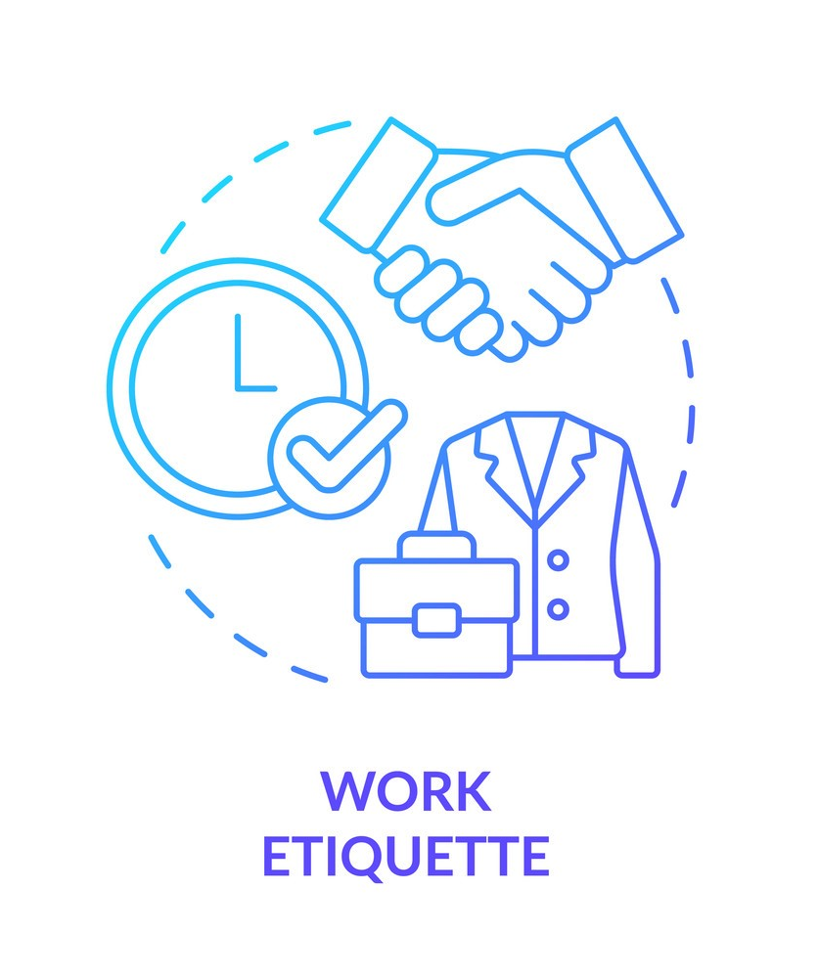
6. Confidentiality etiquette: This entails respecting confidentiality agreements, handling sensitive information with care, and avoiding discussing confidential matters inappropriately. 7. Technology etiquette: This includes using technology responsibly, such as avoiding excessive personal use of devices during work hours, refraining from posting inappropriate content on social media, and following cybersecurity protocols. 8. Respect for colleagues' time and space: This involves being mindful of colleagues' schedules, avoiding unnecessary interruptions, and respecting boundaries in both physical and virtual work environments. 9. Conflict resolution etiquette: This encompasses handling conflicts professionally, using respectful language and tone, seeking to understand the perspectives of others, and working towards mutually beneficial solutions. 10. Networking etiquette: This refers to building and maintaining professional relationships, demonstrating courtesy and respect when networking, and following up appropriately after meetings or events.

Slide 9
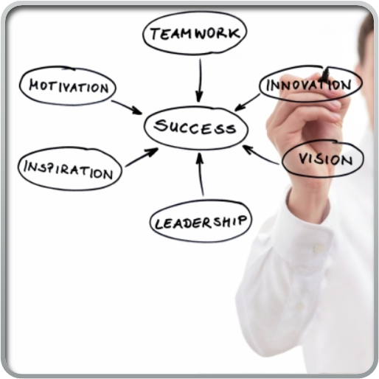
CONCLUSION
In conclusion, workplace etiquette is the
cornerstone of a successful and thriving
workplace.
It sets the tone for respectful
communication, professionalism, and
collaboration.
By practicing courtesy, respect, and
mindfulness in interactions helps to contribute
positive and productive environment that
benefits everyone involved.

Slide 10
Thank you
Presented by:
HEMADHARSHINI S
SHRIKANTH D
KARTHIK G
SATHYA CHANUKYA R

